Slide 1

Machine Learning on Imbalanced Class Distributions
Thamme Gowda
May 27, 2021, NLP Group Meeting

Slide 2
Overview
Imbalanced Classification
Methods
- Sampling - Augmentation
- Objective-based
- Re-weighing
- Smoothing
Experiments
- Image classification
- Mars images dataset
- Model and training
- Results
Discussion
Why should we care?
Next steps

Slide 3
Imbalanced Classification [1/2]
What: Classification problem where class frequency distribution is uneven
Leading to majority and minority classes. Also called frequent and rare classes
Rare classes/types/phenomena are important
Examples:
Cancer detection:
Most people don’t have cancer -- label: NEGATIVE but some people do -- label: POSITIVE. Global average: ~1%; USA: ~5%
Performance on minority class is important Say, imbalance is 99:1, majority class baseline gets 99% accuracy without any learning. Is it useful? No.
NLP/ natural language generation from Zipfian distribution:
Frequent words are stopwords, and rare words are often content words (but sometimes noise)
Performance on content words is more useful than stopwords; stopwords are removed or masked in some apps

Slide 4
Imbalanced Classification: Problems [2/2]
Why do we care?
ML techniques observe good performance on majority classes, but poor performance on minority classes, out-of-the-box. i.e. poor performance on some important classes
Frequency based biases creep in Known behavior: over-recall of majority classes <=> under-recall of minority classes
Recently, worked on evaluation metrics: Macro-average: rare types are important too. NAACL2021
Next research direction: How to improve performance on minority classes? → Machine learning on imbalanced class distributions
Note: Carefully created datasets [used by academia] are often balanced, but the real-world problems are very likely to be imbalanced

Slide 5

From Social Sciences ...
Nature is imbalanced; even the societies are imbalanced There are attempts to address these imbalances Some methods are controversial
“Affirmative action: set of policies and practices within a govt or org seeking to increase the representation of particular groups based on their gender, race, sexuality, creed or nationality in areas in which they are underrepresented such as education and employment” -- Wikipedia.org
Quota system: certain percentage of govt jobs, political positions, and school vacancies reserved for members of certain groups
E.g.,1: Reservation system in India
E.g.,2: USA employment-based immigration: 7% per-country ceiling
Preference or special consideration to minoritized groups in selection processes
E.g., scholarships for students
Imbalance is everywhere in nature, people, society ...

Slide 6
Imbalanced Machine Learning: Methods
Sampling based methods [similar to quota system]
Up-sample minority class(es)
Down-sample majority class(es)
Augmentation methods
SMOTe: Synthetic Minority Oversample Technique
Modified objective [preference or special consideration]
Frequency based:
Weighted Cross Entropy with inverse frequencies
Likelihood based
Focal Loss
Label Smoothing
⬅ Focusing on Modified Objectives.
Imbalance is inevitable in NLP (my focus). Attaining class balance via sampling and synthetic augmentation is hard.

Slide 7
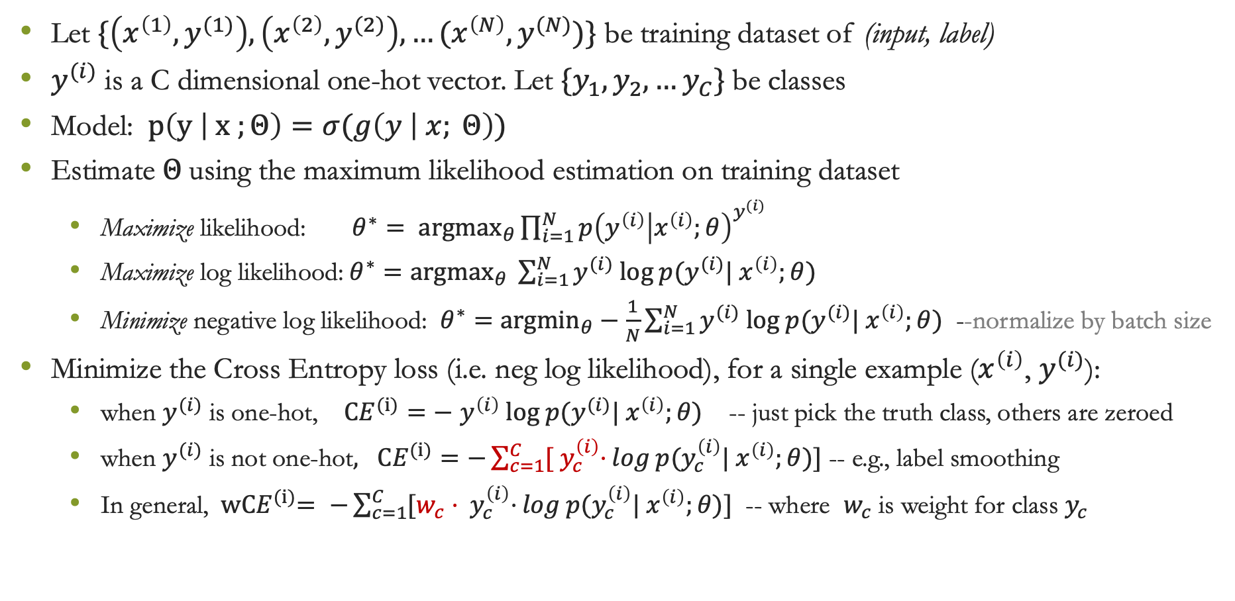
Cross Entropy
Let $\{\left(x^{\left(1\right)},y^{(1)}\right), \left(x^{\left(2\right)},y^{(2)}\right), …(x^{\left(N\right)},y^{(N)})\}$ be training dataset of (input, label)
$y^{(i)}$ is a C dimensional one-hot vector. Let ${\{y}_{1},y_{2},…y_{C}\}$be classes
Model: $p\left(y | x ;Θ\right)=σ(g\left(y | x; Θ\right))$
Estimate $Θ$using the maximum likelihood estimation on training dataset
Maximize likelihood: ${θ^{∗}= argmax}_{θ}\prod_{i=1}^{N}{p{\left(y^{\left(i\right)} | x^{\left(i\right)};θ\right)}^{y^{(i)}} }$
Maximize log likelihood:$θ^{∗}={argmax}_{θ} \sum_{i=1}^{N}{y^{(i)} log p(y^{(i)}| x^{\left(i\right)};θ)}$
Minimize negative log likelihood: $θ^{∗}=$ ${argmin}_{θ}−\frac{1}{N}\sum_{i=1}^{N}{y^{(i)} log p(y^{(i)}| x^{\left(i\right)};θ)}$ --normalize by batch size
Minimize the Cross Entropy loss (i.e. neg log likelihood), for a single example ($x^{\left(i\right)}$, $y^{(i)}$):
when $y^{(i)}$ is one-hot, ${CE}^{(i)}=−$ $y^{\left(i\right)} log p(y^{(i)}| x^{\left(i\right)};θ)$ -- just pick the truth class, others are zeroed
when $y^{(i)}$ is not one-hot$, {CE}^{(i)}=−\sum_{c=1}^{C}{{[ y}_{c}^{\left(i\right)}⋅}log p(y_{c}^{\left(i\right)}| x^{\left(i\right)};θ)]$ -- e.g., label smoothing
In general, ${ wCE}^{(i)}= −\sum_{c=1}^{C}{{[w_{c}⋅ y}_{c}^{\left(i\right)}⋅}log p(y_{c}^{\left(i\right)}| x^{\left(i\right)};θ)]$ -- where $w_{c}$ is weight for class $y_{c}$

Slide 8
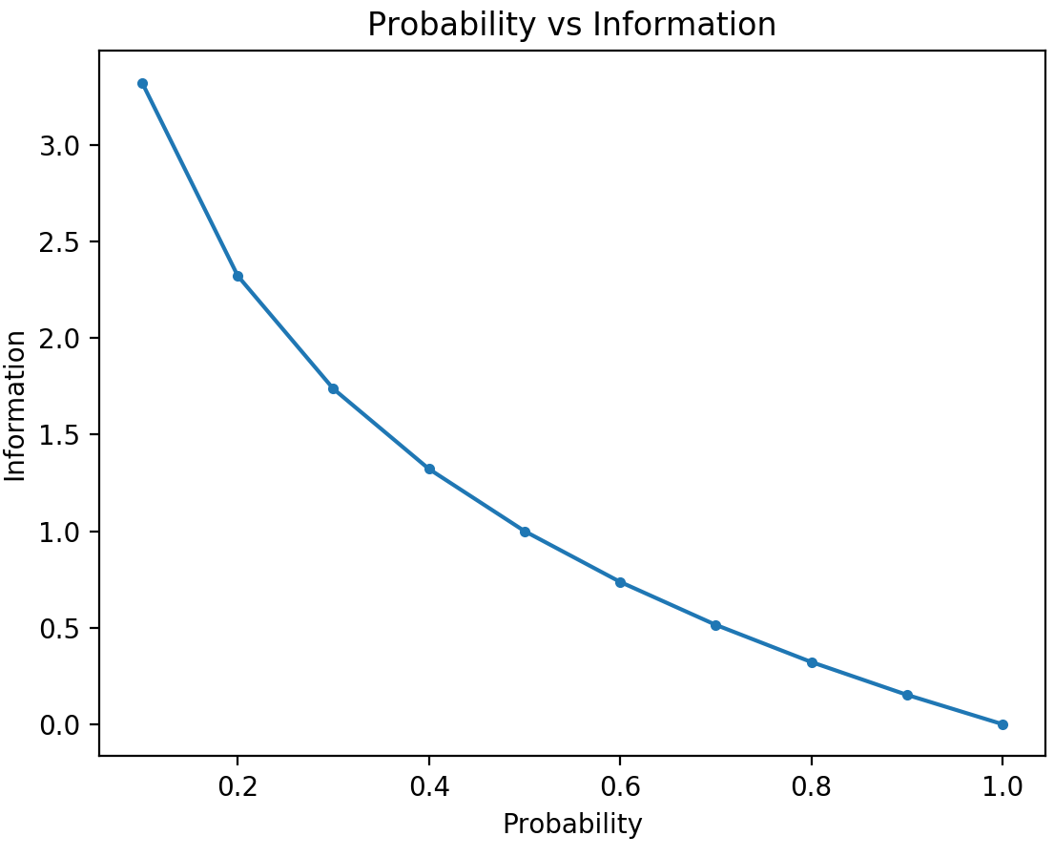
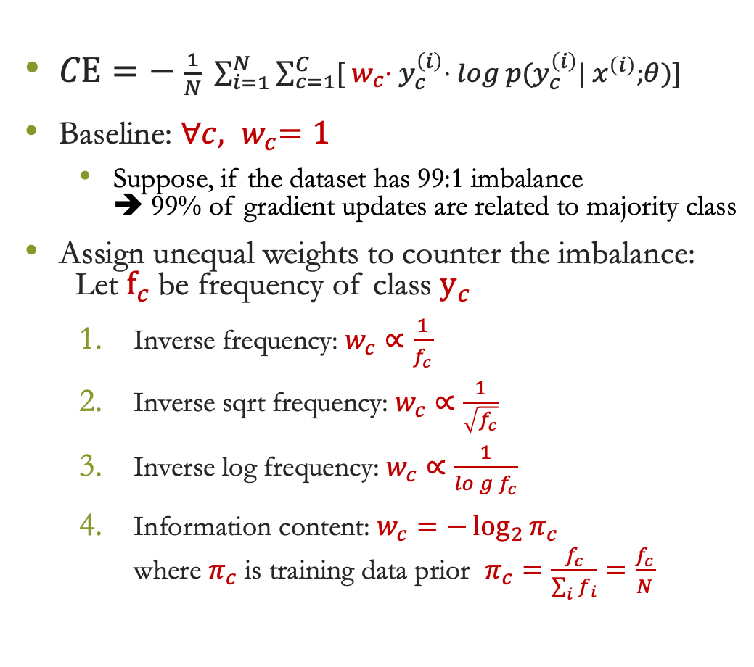
Weighted Cross Entropy
$CE=− \frac{1}{N} \sum_{i=1}^{N}{\sum_{c=1}^{C}{{[{ w}_{c}⋅ y}_{c}^{\left(i\right)}⋅} log p(y_{c}^{\left(i\right)}| x^{\left(i\right)};θ)]}$
Baseline: ${∀c, w}_{c}=1$
Suppose, if the dataset has 99:1 imbalance ➔ 99% of gradient updates are related to majority class
Assign unequal weights to counter the imbalance: Let $f_{c}$be frequency of class $y_{c}$
Inverse frequency: $w_{c}∝\frac{1}{f_{c}}$
Inverse sqrt frequency: $w_{c}∝\frac{1}{\sqrt{f_{c}}}$
Inverse log frequency: $w_{c}∝\frac{1}{log{f_{c}}}$
Information content: $w_{c}=−\log_{2}{π_{c}}$ where $π_{c}$ is training data prior $π_{c}=\frac{f_{c}}{\sum_{i}{f_{i}}}=\frac{f_{c}}{N}$
Notes:
$1/x$ is too harsh, $1/\sqrt{x}$ is smooth and $1/\log\left(x\right)$ is smoother

Slide 9
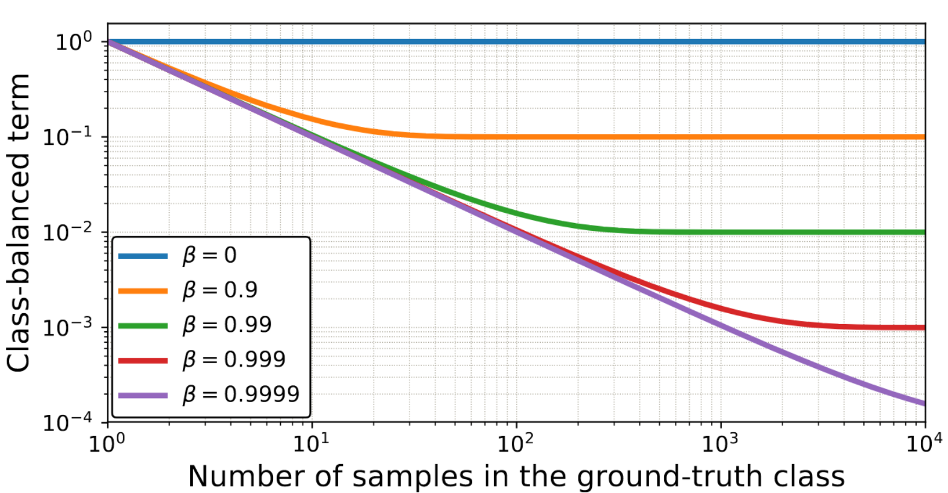
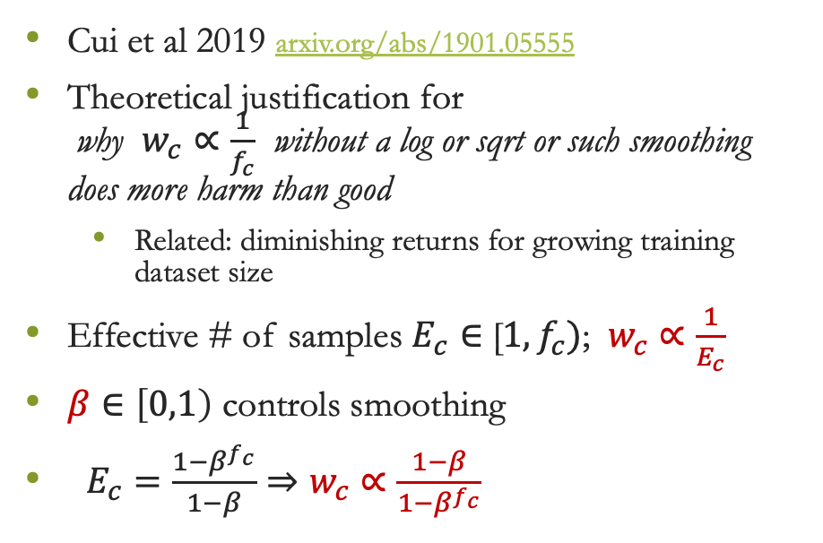
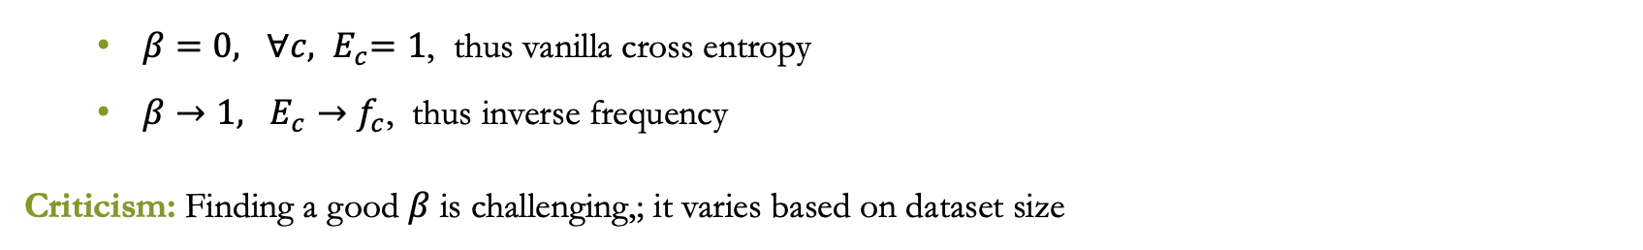
Effective Number of Samples
Cui et al 2019 arxiv.org/abs/1901.05555
Theoretical justification for why $w_{c}∝\frac{1}{f_{c}}$ without a log or sqrt or such smoothing does more harm than good
Related: diminishing returns for growing training dataset size
Effective # of samples $E_{c}∈$ [$1, f_{c})$; $w_{c}∝\frac{1}{E_{c}}$
$β∈\left[0,1\right)$ controls smoothing
$E_{c}=\frac{1−β^{f_{c}}}{1−β}⇒w_{c}∝\frac{1−β}{1−β^{f_{c}}}$
$β=0, {∀c, E}_{c}=1$, thus vanilla cross entropy
$β→1, E_{c}→f_{c}$, thus inverse frequency
Criticism: Finding a good $β$ is challenging,; it varies based on dataset size

Slide 10
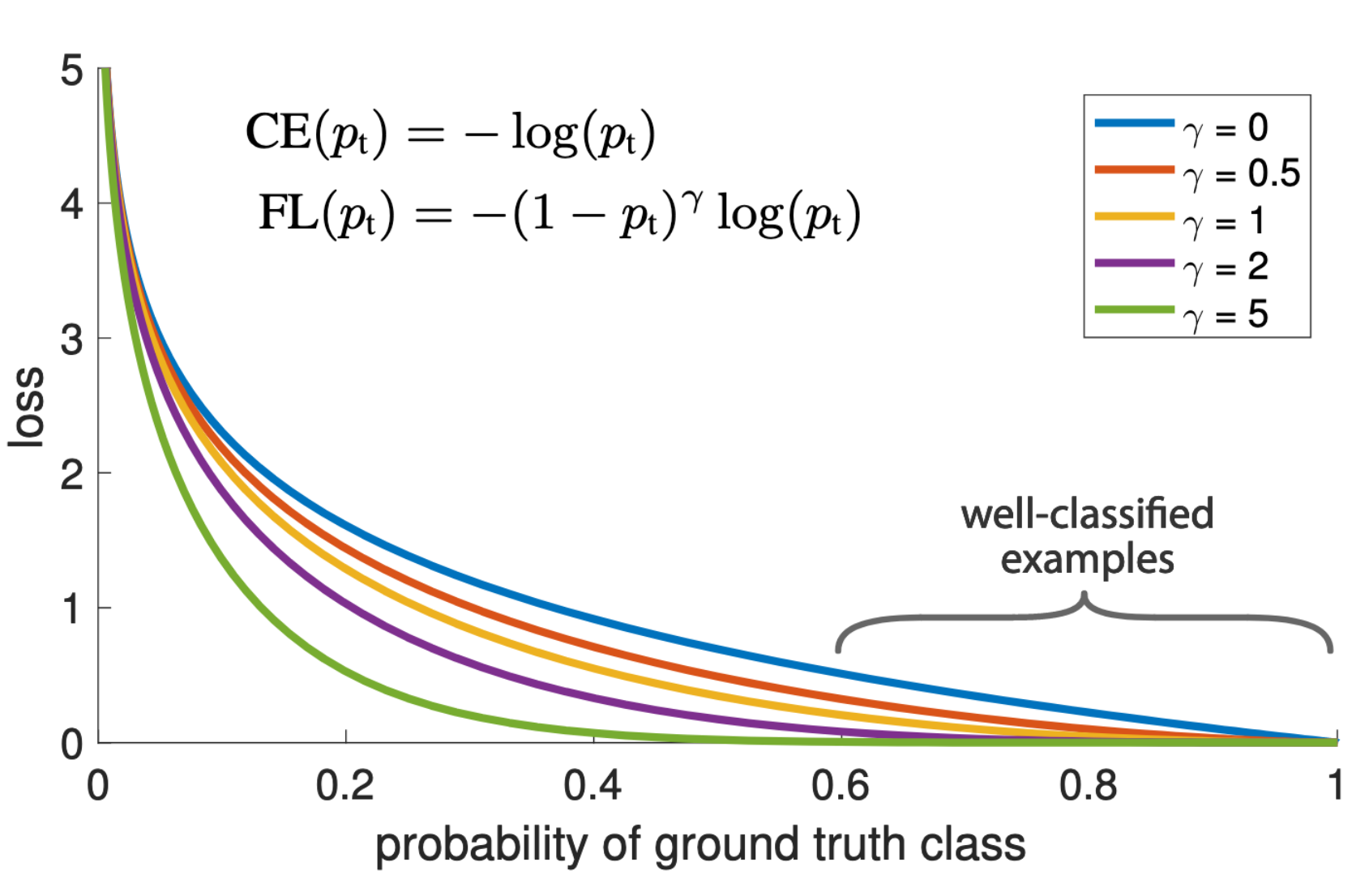
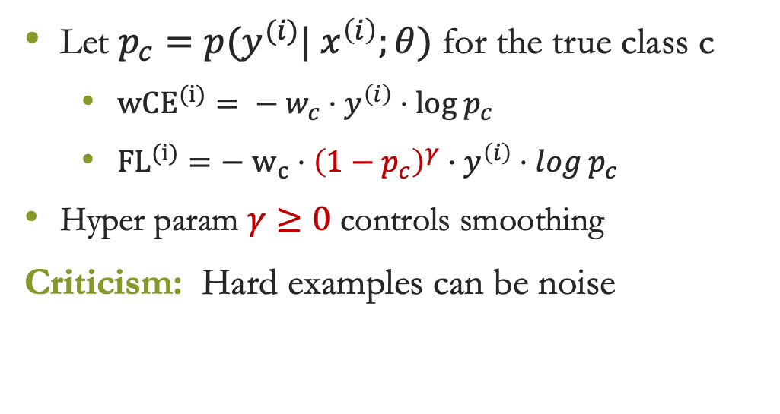
Focal Loss
Our assumption so far: minority classes are hard, majoroity classes are easy
But... majority classes may also have hard examples, and minority too may have easy examples
Focal Loss – Yin et al 2017 arxiv.org/abs/1708.02002
Key idea: relax penalty for easy-to-classify examples regardless of the class they belong to
Let $p_{c}=p(y^{(i)}| x^{\left(i\right)};θ)$ for the true class c
${wCE}^{(i)}= − w_{c}⋅y^{\left(i\right)}⋅log p_{c}$
${FL}^{(i)}=−$ $w_{c}⋅{\left(1−p_{c}\right)}^{γ}⋅y^{\left(i\right)}⋅log p_{c}$
Hyper param $γ≥0$ controls smoothing
Criticism: Hard examples can be noise

Slide 11
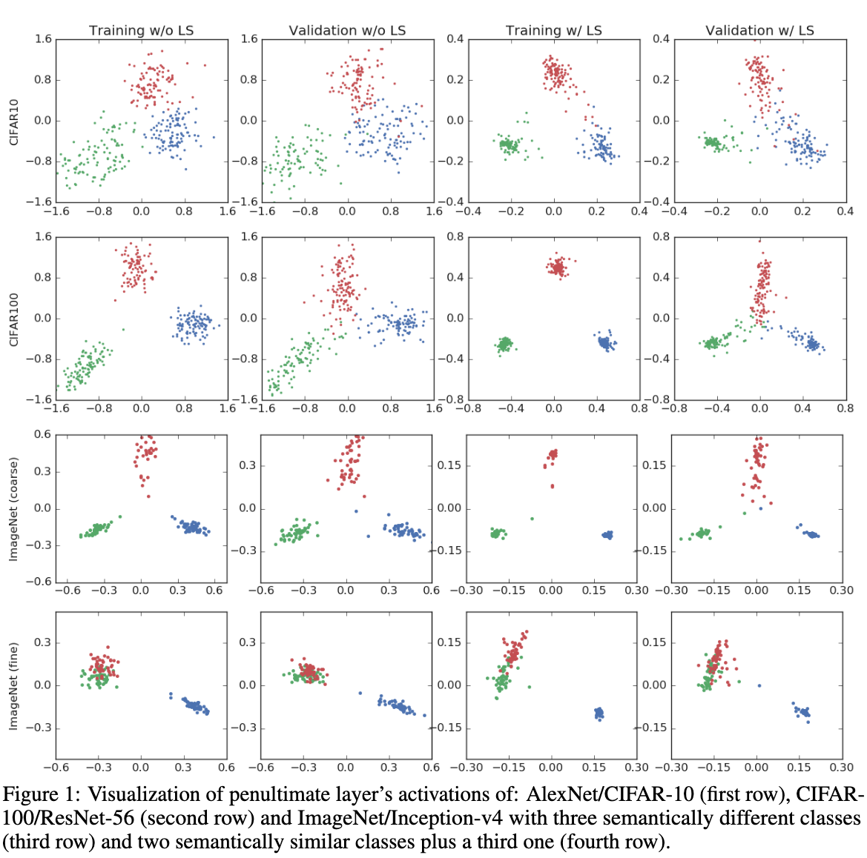
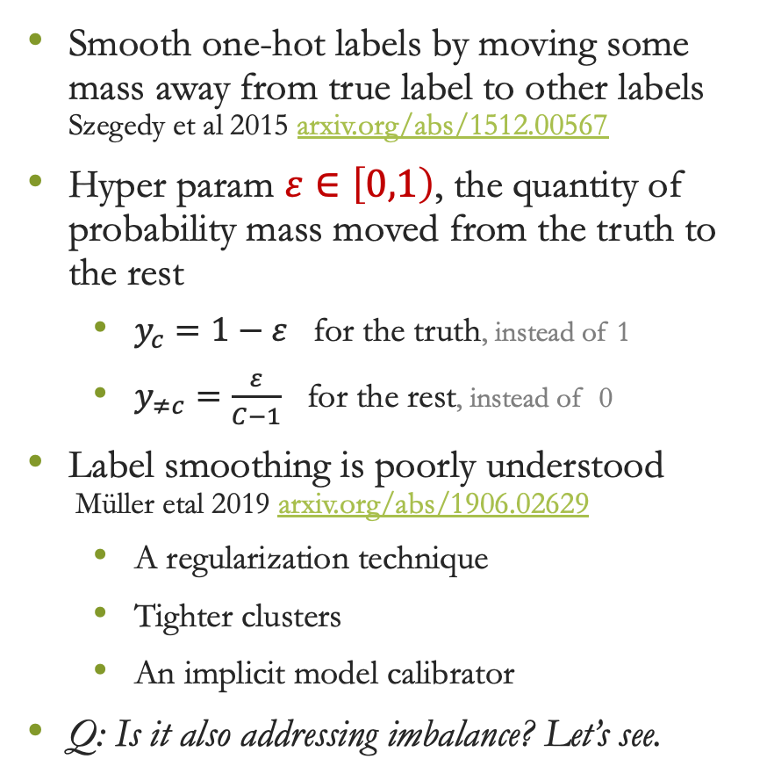
Label Smoothing
Smooth one-hot labels by moving some mass away from true label to other labels Szegedy et al 2015 arxiv.org/abs/1512.00567
Hyper param $ε∈\left[0,1\right)$, the quantity of probability mass moved from the truth to the rest
$y_{c}=1−ε$ for the truth, instead of 1
$y_{≠c}=\frac{ε}{C−1}$ for the rest, instead of 0
Label smoothing is poorly understood Müller etal 2019 arxiv.org/abs/1906.02629
A regularization technique
Tighter clusters
An implicit model calibrator
Q: Is it also addressing imbalance? Let’s see.

Slide 12
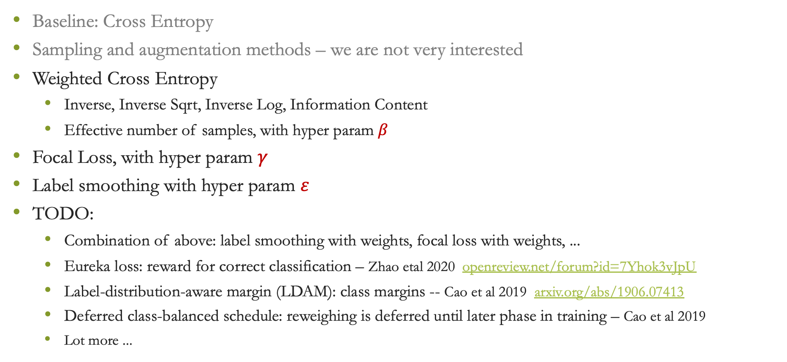
Summary of Methods
Baseline: Cross Entropy
Sampling and augmentation methods – we are not very interested
Weighted Cross Entropy
Inverse, Inverse Sqrt, Inverse Log, Information Content
Effective number of samples, with hyper param $β$
Focal Loss, with hyper param $γ$
Label smoothing with hyper param $ε$
TODO:
Combination of above: label smoothing with weights, focal loss with weights, ...
Eureka loss: reward for correct classification – Zhao etal 2020 openreview.net/forum?id=7Yhok3vJpU
Label-distribution-aware margin (LDAM): class margins -- Cao et al 2019 arxiv.org/abs/1906.07413
Deferred class-balanced schedule: reweighing is deferred until later phase in training – Cao et al 2019
Lot more ...

Slide 13
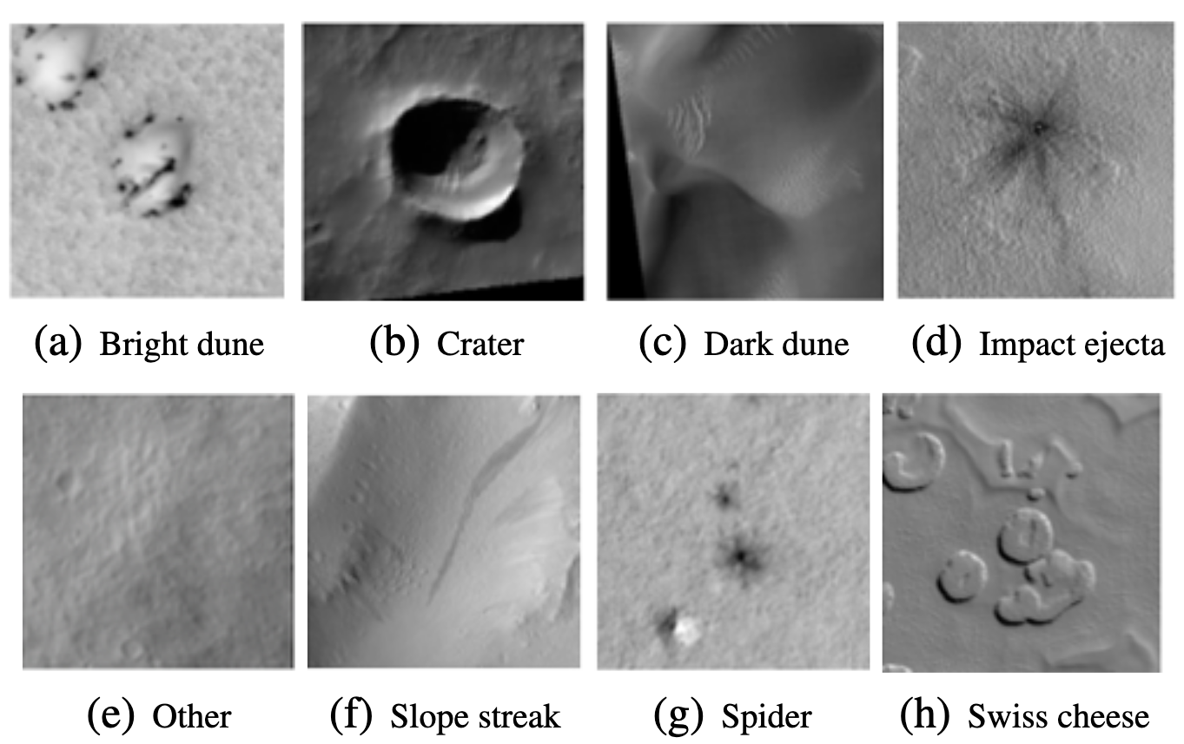
Experiment Setup
Class | Train Freq | Train % | Val Freq | Val %
Other | 40,019 | 81.71 | 11,221 | 79.16
Crater | 3,598 | 7.35 | 1,337 | 9.43
Bright Dune | 1,561 | 3.19 | 77 | 0.54
Swiss Cheese | 1,281 | 2.62 | 511 | 3.60
Slope Streak | 924 | 1.89 | 602 | 4.25
Spider | 637 | 1.30 | 217 | 1.53
Dark Dune | 616 | 1.26 | 84 | 0.59
Impact Ejecta | 343 | 0.70 | 126 | 0.89
Total | 48,979 | 100 | 14,175 | 100
Problem: Image Classification
Dataset:
High Resolution Imaging Science Experiment (HiRISE) v3.2 -- Images taken from Mars satellites Wagstaff et al 2021
8 classes, naturally imbalanced
Model:
ResNeXt -- torchvision.models.resnext50_32x4d()
Last layer is adapted to 8 classes
Training:
Hyper params based on best validation MacroF1
Weights: random initialization Optimizer: Adam lr: 0.0005, betas: [0.9, 0.999] Trained until convergence

Slide 14
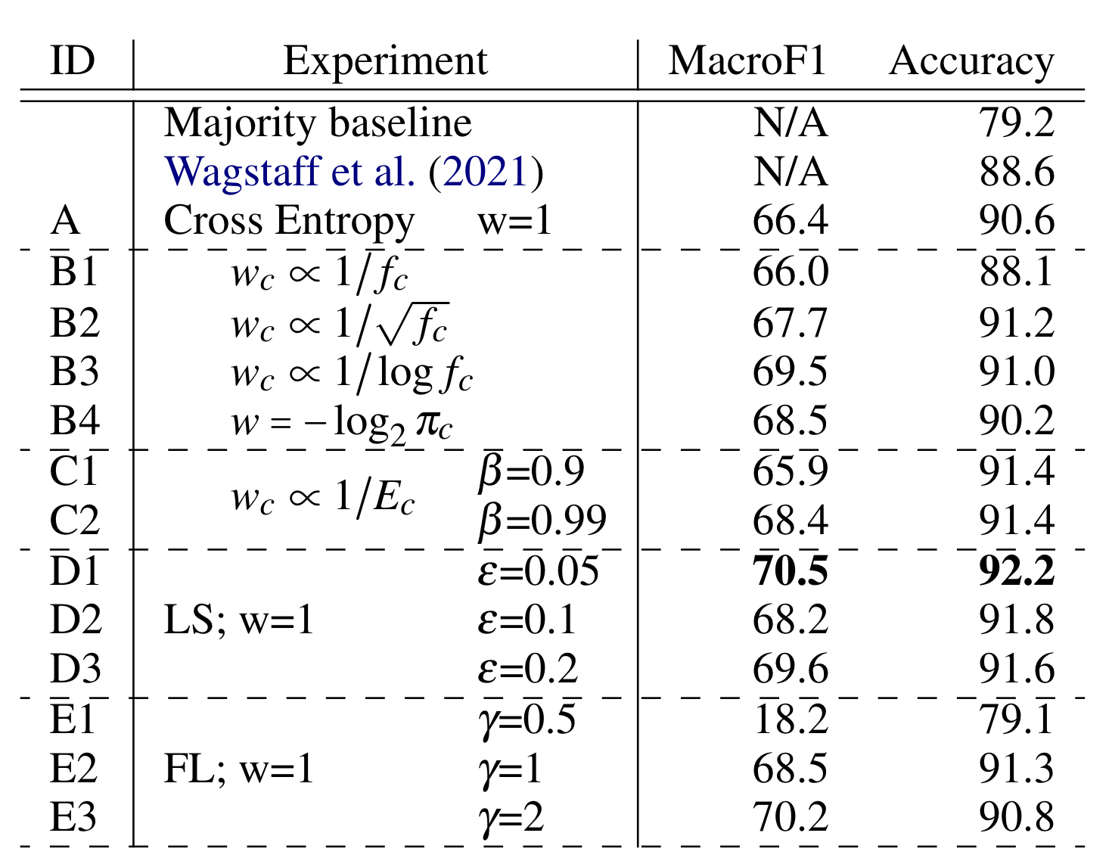
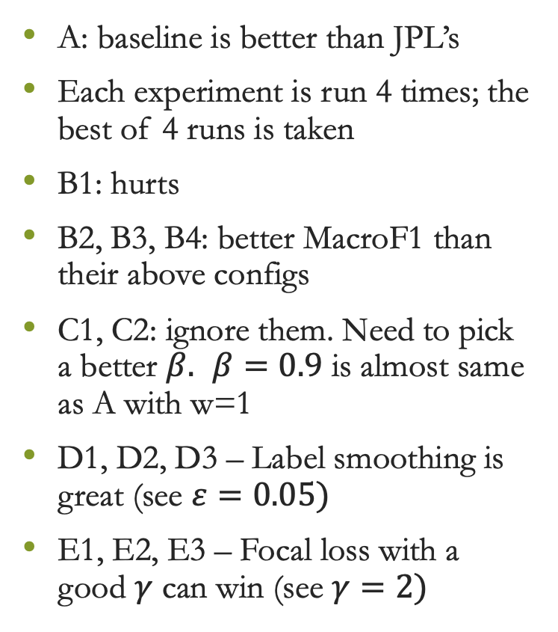
Results: Validation Set
A: baseline is better than JPL’s
Each experiment is run 4 times; the best of 4 runs is taken
B1: hurts
B2, B3, B4: better MacroF1 than their above configs
C1, C2: ignore them. Need to pick a better $β.$ $β=0.9$ is almost same as A with w=1
D1, D2, D3 – Label smoothing is great (see $ε=0.05)$
E1, E2, E3 – Focal loss with a good $γ$ can win (see $γ=2)$
TODO: combine label smoothing with others combine focal loss with weights

Slide 15
Validation Set F-1 Measures
Promising results
Improvements in MacroF1 and Accuracy
A: baseline CE B: wCE inv_freq, inv_sqrt, inv_log , info_cont C: effective # of samples D: label smoothing E: focal loss
Class | Train% | A | B1 | B2 | B3 | B4 | C1 | C2 | D1 | D2 | D3 | E2 | E3
Other | 81.7 | 94.6 | 93.1 | 95.1 | 94.9 | 94.3 | 95.1 | 95.4 | 95.6 | 95.4 | 95.3 | 95.0 | 94.7
Crater | 7.3 | 78.2 | 75.3 | 79.2 | 79.5 | 76.3 | 79.1 | 80.4 | 78.9 | 80.9 | 78.2 | 80.4 | 75.9
Bright Dune | 3.2 | 64.7 | 74.4 | 65.4 | 58.5 | 75.0 | 55.3 | 76.5 | 84.1 | 85.0 | 65.2 | 74.9 | 83.1
Swiss Cheese | 2.6 | 87.7 | 90.7 | 92.8 | 92.0 | 92.1 | 90.7 | 90.2 | 93.7 | 90.4 | 93.3 | 89.4 | 87.7
Slope Streak | 1.9 | 68.9 | 61.6 | 72.8 | 72.6 | 72.3 | 74.9 | 71.3 | 75.1 | 73.4 | 73.6 | 64.7 | 67.7
Spider | 1.3 | 59.7 | 65.0 | 66.1 | 66.5 | 69.6 | 60.1 | 61.1 | 65.0 | 60.2 | 56.6 | 68.4 | 74.1
Dark Dune | 1.3 | 58.1 | 36.3 | 49.8 | 54.2 | 62.8 | 47.7 | 54.3 | 52.4 | 60.3 | 52.4 | 47.7 | 51.8
Impact Ejecta | 0.7 | 19.2 | 31.5 | 20.1 | 37.6 | 5.9 | 24.1 | 17.8 | 18.8 | 0.0 | 42.3 | 27.4 | 26.9
MacroF1 |  | 66.4 | 66.0 | 67.7 | 69.5 | 68.5 | 65.9 | 68.4 | 70.4 | 68.2 | 69.6 | 68.5 | 70.2
Accuracy |  | 90.6 | 88.1 | 91.2 | 91.0 | 90.2 | 91.4 | 91.4 | 92.2 | 91.8 | 91.6 | 91.2 | 90.8

Slide 16
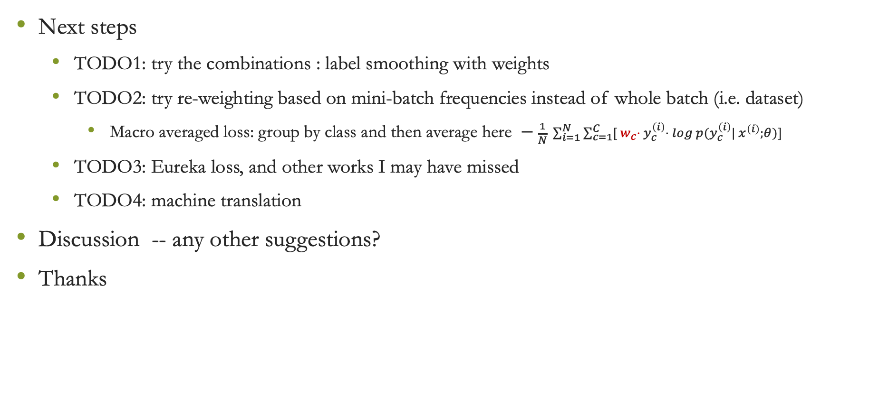
Last Slide
Next steps
TODO1: try the combinations : label smoothing with weights
TODO2: try re-weighting based on mini-batch frequencies instead of whole batch (i.e. dataset)
Macro averaged loss: group by class and then average here $− \frac{1}{N} \sum_{i=1}^{N}{\sum_{c=1}^{C}{{[{ w}_{c}⋅ y}_{c}^{\left(i\right)}⋅} log p(y_{c}^{\left(i\right)}| x^{\left(i\right)};θ)]}$
TODO3: Eureka loss, and other works I may have missed
TODO4: machine translation
Discussion -- any other suggestions?
Thanks

